Slide 1

Concerning Death and Resurrection
The Most Important Point of All
Week 70
08 November 2023

Slide 2

1 Corinthians introduction
To begin this new section let’s take a look at where we’ve been in this first letter to the Corinthians and where we are going:
Opening Greeting and Prayer (1:1-9).
Rebuking Divisions and Folly (1:10 – 3:23).
Correcting Ills and Immorality (4:1 – 6:20).
Strengthening Family and Fellowship (7:1 – 10:33).
Ordering Church and Worship (11:1 – 14:40).
Concerning Death and Resurrection (15:1-58).
Concluding Instructions and Warning (16:1-24).
In this sixth section (15:1-58). Paul reiterates the message of the gospel and the person and work of Jesus Christ, then he dives into the depths of the doctrine Concerning Death and Resurrection.

Slide 3
1 Corinthians Introduction
As we continue our study in First Corinthians, we want to remember that the theme of this letter revolves around Christian Conduct in the local church and how it influences unity, discipline, and spiritual growth …
Again, the primary issue in the church at Corinth was “Progressive Sanctification” – the development of Holy character and the application of Christian principles and discipline on an individual and corporate level. So the corrective in this letter is behavior rather than doctrine.
In this study, Paul reminds believers of the core message of the gospel, addresses the historical reality of Christ's resurrection, underscores the centrality and the significance of the resurrection to the Christian faith, and the importance of continuing to hold fast to our faith for ongoing salvation. He also highlights his apostolic humility and reliance on God's grace for the work of ministry.

Slide 4
1 Corinthians Introduction
Reflecting on the early days of the apostles, Swindoll says, since those days two categories of errors have weaseled their way into the Christian faith.
Errors that challenge both Orthodoxy (right belief) and Orthopraxy (right practice).
Orthodoxy … pertains to correct belief and doctrine, within a religious tradition or belief system. It is concerned with the right understanding of essential theological or philosophical principles, dogmas, and doctrines.
Orthopraxy … focuses on correct religious practice and ethical conduct. It emphasizes the importance of adhering to prescribed rituals, moral codes, and ethical behaviors. Though both of these serious error must be resisted, there is a clear distinction in the severity between them.

Slide 5
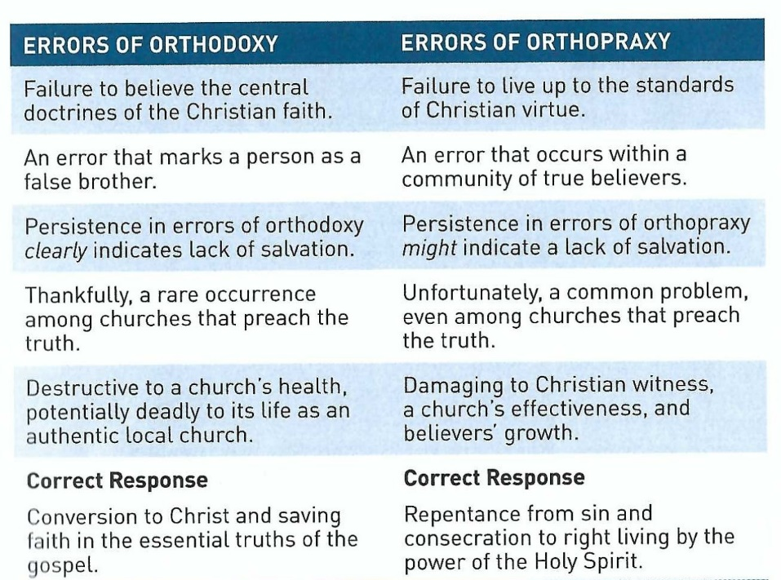
1 Corinthians Introduction
Let’s examine these errors side-by-side:

Slide 6
1 Corinthians Introduction
Paul had primarily addressed the church’s errors of orthopraxy, in this letter. Showing how that had failed to live up to the Christian virtues of love, unity, peace, morality and humility that should have characterized growing, Spirit-filled believer.
At times, the heinousness of their moral failure may have led Paul to question the genuineness of some of their conversions (5:11-13, 6:9-10); yet as a whole, Paul regarded the Corinthians believers to be genuine Christians struggling with immaturity and carnality (1:4-9; 6:11).
In light of the challenges of orthopraxy in Corinth, chapter 13 can be regarded as the “practical pinnacle” of the treatise.

Slide 7
1 Corinthians Introduction
In chapter 15, however, Paul makes a sudden transition from serious issues of orthopraxy to a severe issue of orthodoxy, making this chapter the theological summit of this letter.
So, again Paul begins to attach this issue by reiterating that which is “of first importance” – the message of the gospel of the person and work of Jesus Christ (15:1-11).
Then from this center and source of our Christian faith – He takes us into the atoning death and life-giving resurrection of Jesus Christ; while detailing the doctrine of our own future resurrection at the return of Christ (15:12-58).

Slide 8
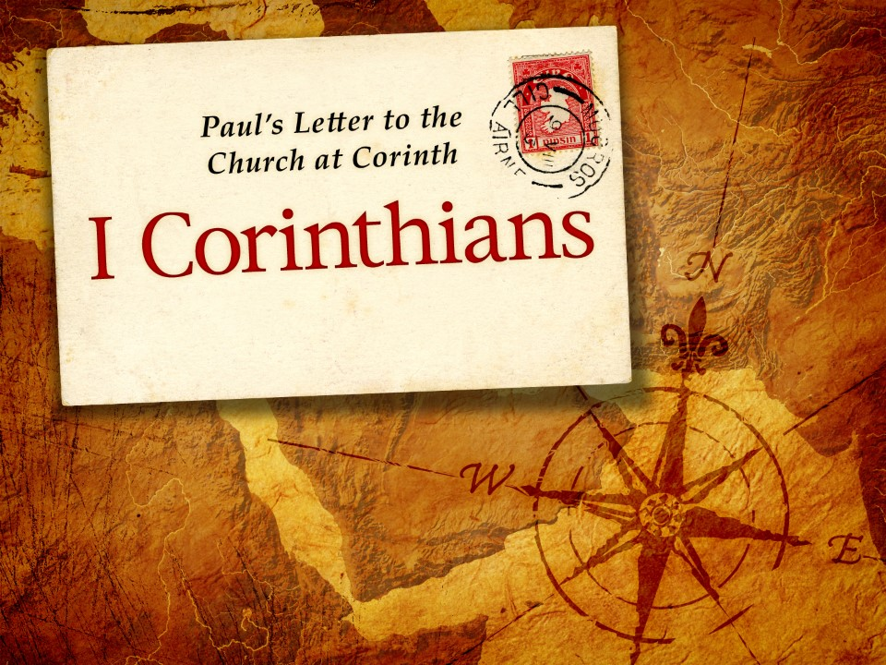
The Most Important Point of All
15:1-11

Slide 9
1 Corinthians - Lesson Overview
Swindoll … opens this study with a history lesson on the influence of the famed city of Athens once consider by many to be the ancient “crossroads of intelligentsia.”
He says, when people travel to Greece for the first time, most have one major destination in mind: the famed city of Athens. To this day, the name “Athens” is synonymous with “philosophy,” “culture,” and “civilization.”
For centuries, Athens could stake it claim as the ancient crossroad of intelligentsia. Though the world was owned and operated by Rome, the most learned men of the Empire got their philosophical concepts from a hill in the city of Athens called the “Areopagus,” or “Mars Hill.”

Slide 10
1 Corinthians - Lesson Overview
It was there that the greatest Greek thinker formulated and popularized views on politics, religion, culture, and philosophy that would endure for millennia.
There Paul had both the privilege and challenge of presenting Christ to the intelligentsia of the Greek speaking world. His preaching was characterized by unwavering truth and tactful diplomacy.
Meeting them on their own soil, establishing common ground, and even quoting from their own Greek poets, Paul could engage the Greek thinkers in ways that captured their hearts and their minds, until a very specific part of the Christian truth turned them off: “when they heard of the resurrection of the dead, some began to sneer” (Acts 17:32).

Slide 11
1 Corinthians - Lesson Overview
So, the resurrection of the dead is for many the great “Continental Divide” between faith and unbelief.
Located near Athens, Corinth was greatly influenced by this Greek mind-set. Being a city that valued pleasure above learning, Corinth left the thinking to her Athenian neighbors, adopting without question their attitudes toward the resurrection of the body.
The eagerness to appear “wise” by the world’s standards had been a constant objective among the Corinthians (1:18-25).
In 15:1-11, we discover that some felt tempted to succumb to the pressure of philosophical respectability by denying one of the make–or-break doctrines of the Christian faith: the bodily resurrection of Jesus Christ.

Slide 12
1 Corinthians - Lesson Overview
Perhaps they started by reinterpreting the promise of a believer’s own bodily resurrection, arguing that it was a “spiritual” resurrection rather than a “physical” rising from the dead. However, this doctrinal error took a dangerous step toward the rejection of Christ’s resurrection.
When we read Paul’s thorough and passionate treatment of Christ’s resurrection in this chapter, it is easy to surmise that a few in Corinth already were softening this philosophically offensive claim of the Christian faith.
That on the third day, Jesus miraculously and bodily arose from the dead. Clearly, the very heart of orthodoxy was at stake – and it still is.

Slide 13
1 Corinthians - Lesson Overview
Paul makes it clear: Christ’s miraculous, bodily resurrection from the dead is not up for grabs. It never has been and it never will be.
That Christ had been raised from the dead was not the controversy in Corinth. Yes! there were a few doubters – men and women who did not yet believe – who hung out among the Corinthian Christians.
But the church as a whole had no problem accepting both the death and resurrection of Jesus. Yet, some believers in Corinth had capitulated to the Greek philosophers’ disdain for the material body to such a degree that they were denying their own physical resurrections.

Slide 14
1 Corinthians - Lesson Overview
While they were clear on the resurrection of Jesus, they were confused about the destinies of their own bodies.
Even today, many Christians are quite confused about the order of our redemption and resurrection and how our bodies are involved in God’s ultimate plan for salvation.
Some believers have a foggy picture of what the people of God experience whey they die, where they go, and what happens next.
Too often people say, “When we die and go to heaven, we will finally be whole.” Not so!
Or they claim, “Once we escape from our earthly bodies, we will finally enjoy perfect bliss in heaven forever.” Not true!

Slide 15
1 Corinthians - Lesson Overview
Both of these ideas incorporate only half the story, failing to tell the rest of God’s plan for full redemption of both soul and body, immaterial and material, spiritual and physical.
To challenge that incomplete picture of our redemption, Paul begins with the epicenter of all thing Christian – the miraculous resurrection of Jesus Christ from the dead.
The heartbeat of Christianity is the good news of Christ’s atoning death and glorious resurrection. Understanding these essential gospel truths about the person and work of Jesus Christ will regulate both doctrine and practice.
So, Paul turns to this core of orthodoxy in order to set the Corinthians straight on the vital concern over the nature of our own resurrection bodies.

Slide 16
1 Corinthians 15:1-5
¹Moreover, brethren, I declare to you the gospel which I preached to you, which also you received and in which you stand, ²by which also you are saved, if you hold fast that word which I preached to you—unless you believed in vain. ³For I delivered to you first of all that which I also received: that Christ died for our sins according to the Scriptures, ⁴and that He was buried, and that He rose again the third day according to the Scriptures, ⁵and that He was seen by Cephas, then by the twelve.

Slide 17
1 Corinthians 15:1-5
The message of gospel is both simple and profound. It can be expressed in five words – “Jesus died and rose again” – or it can be expounded in sixteen chapter (Romans 1-16).
We can describe what we mean by “Jesus” (the person of Christ), we can detail the saving significance of Christ’s death (the substitutionary atonement), and we can defend the historicity of the bodily resurrection of Jesus (apologetics).
Even young children, can learn the basic content of the gospel message: “Jesus died and rose again.”
So, because of the Corinthians’ problems, the apostle focuses his review of the gospel on the resurrection of Jesus Christ.

Slide 18
1 Corinthians 15:1-5
Now, as Paul makes the gospel known to his readers, he does not leave the other crucial issues unmentioned. So, for the sake of simplicity and clarity, Paul describes the process of passing on the gospel (15:1), the objective of the gospel (15:2), and the content of the gospel (15:3-5).
The Process . . . In 15:1, Paul recaps for the Corinthians the process by which they had originally received the gospel message. He takes them back to the time when he was personally present, and preached the gospel to them.
He reminds them that they had “received” the gospel. Not only did they receive it be faith, but they continue to “stand” in it. Indicating that Paul had confidence that they were “standing firm” in the gospel.

Slide 19
1 Corinthians 15:1-5
Also reminding us that those who had utterly rejected the essential content of the gospel at Corinth, were in the minority among a vast majority of genuine believers.
The Objective . . . In 15:2, the objective of the gospel becomes clear: “by which also you are saved.” Notice Paul doesn’t refer to their salvation as a past event, as he did in Ephesians 2:8, “By grace you have been saved through faith.”
Nor does he use the future aspect of salvation as entry into eternal reward after the last judgment, as in 3:15, “He himself will be saved.”
Paul refers to “sanctification salvation” or “progressive sanctification” – an ongoing process by which believers are conformed to the image of Christ by putting off the deeds of the flesh and making alive the deeds of the Spirit.

Slide 20
1 Corinthians 15:1-5
In this context, the “word” Paul preached in Corinth refers to the daily denial of self, taking up one’s cross, and following the Lord (Luke 9:23).
Paul is saying that if our practical lives are not reflecting the truth of the gospel we accepted, then we have believed in vain – that is, to no practical result. Here, the Corinthians are exhort to apply what they have learned.
To apply their “Orthodoxy” so as arrive at “Orthopraxy” – right belief conformed to right living.

Slide 21
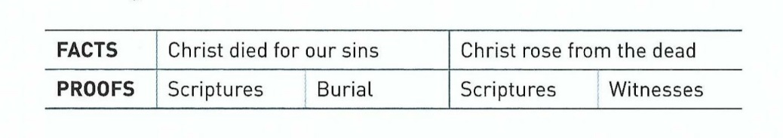
1 Corinthians 15:1-5
The Content . . . In 15:3-5, Paul presents the content of the gospel message. In as compact and simple language as possible, he reminds the Corinthians of the essence of the gospel, with these two facts and two irrefutable evidence for each fact.
The fact that Christ died has always been undeniable, even the skeptical critic of Christianity will acknowledge that Jesus of Nazareth died.
It takes no faith to believe this irrefutable fact of history.

Slide 22
1 Corinthians 15:1-5
FIRST – that Christ died for our sins. Paul presents this essential tenet of the gospel as a matter of faith not directly evident in the events of Christ’s death and burial.
So, God’s special revelation of the significance of the Messiah’s death must interpret the meaning of this historical fact.
We find scriptural proof in the Old Testament prophecy of Isaiah 53:5-9, that told of the coming Messiah written seven hundred years prior to the advent of Jesus.
Then Jesus burial proved the historical fact of His death. Scripture proved the saving significance of His death as a substitutionary atonement for our sin: He died in our place so we could be eternally freed from the penalty of death.

Slide 23
1 Corinthians 15:1-5
SECOND – that Christ rose from the dead. Paul presents this essential tenet of the gospel as a fact verified by a long list of eyewitnesses – including Paul himself – most of whom were still alive when he wrote his words to the Corinthians (15:6).
Yet, even the resurrection of Christ had been predicted in the Old Testament prophecy of Isaiah 53:10-12 > “Yet it pleased the Lord to bruise him; he hath put him to grief: when thou shalt make his soul an offering for sin . . .”
This same prophecy of the resurrection had been fulfilled by Jesus of Nazareth, and was confirmed to Paul and hundreds of other eyewitnesses through a variety of appearances.

Slide 24
1 Corinthians 15:5-8
⁵and that He was seen by Cephas, then by the twelve. ⁶After that He was seen by over five hundred brethren at once, of whom the greater part remain to the present, but some have fallen asleep. ⁷After that He was seen by James, then by all the apostles. ⁸Then last of all He was seen by me also, as by one born out of due time.

Slide 25
1 Corinthians 15:5-8
It doesn’t take faith to believe Jesus died, but to believe in the miraculous, bodily resurrection of Jesus takes great faith. People don’t just come to life again after being dead for thirty-six hours.
Resurrection wasn’t any more believable in the first century than it is in the twenty-first century. That is why Jesus appeared repeatedly, not only to his closest disciples but also to doubters.
In Acts 1:3, Luke describes the numerous encounters with the risen Christ this way, “To these He also presented Himself alive after His suffering, by many convincing proofs, appearing to them over a period of forty days and speaking of the things concerning the kingdom of God” (NASB).

Slide 26
1 Corinthians 15:5-8
Luke was not a historian rummaging through a collection of rumors and legends. Luke was himself a personal companion of Paul and other firsthand witnesses of the life, death and resurrection of Jesus (Luke 1:1-2).
Luke emphasizes the fact that the appearances of Jesus were real, not just momentary glimpses out of the corners of their eyes, but prolonged visits with their Master and Lord.
Rather than being subjective visions and dreams, they were real group experience with the risen Savior – walking with Him, eating with Him, touching Him, and talking with Him.
In 15:5-8, Paul mentions at least six different episodes of Christ appearance.

Slide 27
1 Corinthians 15:5-8
To Cephas (Peter)
To the twelve
To more than five hundred at one time
To James, the brother of Jesus
To all the apostles
To Paul himself
So, with both prophetic scripture and the numerous eyewitnesses of the risen Lord pointing to the bodily resurrection of the crucified Messiah.
There could be no doubt in the minds of hundreds of original disciples that Jesus of Nazareth had miraculously risen from the dead.

Slide 28
1 Corinthians 15:5-8
Physically – in the same body that had been crucified and buried – Jesus was both restored and glorified, His body transformed into a perfect, immortal condition, no longer susceptible to suffering and death.
Fit for glory, Jesus Christ conquered death not only for Himself but also for all who would believe on Him for eternal life.

Slide 29
1 Corinthians 15:8-11
⁸Then last of all He was seen by me also, as by one born out of due time. ⁹For I am the least of the apostles, who am not worthy to be called an apostle, because I persecuted the church of God. ¹⁰But by the grace of God I am what I am, and His grace toward me was not in vain; but I labored more abundantly than they all, yet not I, but the grace of God which was with me. ¹¹Therefore, whether it was I or they, so we preach and so you believed.

Slide 30
1 Corinthians 15:8-11
Now Paul gets personal in 15:8-11, he tells us what the resurrection means in his own life and adds his own unimpeachable firsthand testimony to the authenticity of the Resurrection.
He says, “As by one born out of due time” indicating that his witness to the risen Lord was unique. This description refers to a child born too early – a “premature birth.”
Paul describes himself here by contrasting his background to that of the other apostles – those who had been chosen, handpicked, trained, and developed at the feet of Jesus.
When they were born into the apostleship, they were ideal examples of the kind apostles Christ wanted to raise.

Slide 31
1 Corinthians 15:8-11
Then “Paul the preemie” came along. He had been a vile, hateful persecutor of the church(15:9), nowhere near willing or ready to accept Jesus as Lord and Savior.
Yet, the Lord appeared to him and saved him in the very midst of his aggressively rebellious activities.
From that moment on, Paul’s sudden, dramatic, and otherwise inexplicable transformation from Saul the anti-Christian persecutor to Paul the go-for-broke apostle would become a testimony to the truthfulness of the resurrection of Jesus that baffles historians to this day.
No reasonable explanation can be found for Paul’s conversion to Christ other than the fact of the resurrection of Jesus Christ.

Slide 32
1 Corinthians 15:8-11
The reality of the Resurrection radically and permanently changed the course of Paul’s life. Because he had once viciously persecuted the church, he knew that he was unfit for salvation much less for a ministry as an apostle (15:9).
Because of the great extent of his rebellion against Christ, Paul understood far more than most the miracle of God’s grace (15:10). In light of his former server antagonism toward Christians, Paul rightly attributed his calling and his ministry to the unmerited grace of God (15:10).
In thankful response to this calling, Paul determined to put the grace of God to good work – not to earn or to secure salvation, but to show his love toward the one who had rescued him.

Slide 33
1 Corinthians 15:8-11
Empowered by the miraculous grace of God, Paul kicked in into high gear as he determined to live the rest of his life in the Master’s service.
Now, he points out what was obvious to everybody, “I labored even more than all of them,” referring to all the other eyewitnesses of the resurrected Jesus (15:10).
He acknowledges that his missionary accomplishments did not result from his own efforts, but only because of the grace of God working through him, and other apostles who were all a part of the same team (15:11).
The person and work of Jesus Christ alone—not the preacher who delivers the message—is all that is needed to save the undeserving sinner.

Slide 34
Applications
Of the
lesson
Signs of Our Own Resurrection Life

Slide 35
Application – signs of our own resurrection life
In closing Swindoll reminds us that . . . “Paul’s encounter with the resurrected Savior on the road to Damascus marked an irreversible turning point in his life” (Acts 9:1-8).
“There the spiritually dead, depraved, condemned sinner—bent on destroying the church of Christ—was spiritually raised from the dead, forgiven of his sins, and recruited into the service of the king.”
“Like Paul, all of us who have believed in Christ have been plucked from our rebellious, wayward paths. We may not have persecuted Christ’s cause in the same way Paul did, but we all denied the saving power of His death and the reality of His victorious resurrection in our own ways (Isa. 53:6).

Slide 36
Application – signs of our own resurrection life
Just as He did with Paul, so Jesus has brought salvation even to us!
As a result of His unmerited grace, God has not only given us eternal life through faith in the death and resurrection of His Son.
But, He has given us the presence of His Holy Spirit—the Lord and life giver—to put to death our sinful lifestyles and raise us in newness of life.
As we review Paul’s reflection on his miraculous encounter with God’s resurrection life, we can glean four signs that prove we have not believed in vain, that we are daily dying to our sinful selves, and that we are being raised to a life of obedience in Christ (Romans 6:1-11).

Slide 37
Application – signs of our own resurrection life
FIRST – Paul exhibited no pride (15:9). He openly admitted his unworthiness, refused to compete with his peers, and recognized his own weakness.
What about you? Do you have an inflate view of your own significance?
How important is it to you that you be noticed, commended, rewarded and recognized for your work in the church?
Reflect on the sinful lifestyle or state of rebellion from which God has saved you, and then banish pride and any spirit of entitlement from your thinking.

Slide 38
Application – signs of our own resurrection life
SECOND – Paul had a genuine appreciation for grace (15:10). Paul attributed everything valuable in his life to God’s grace: “But by the grace of God I am what I am.”
Does your life reflect these words?
Do you recognize that without Him you can do nothing?
Do you attribute your successes to His grace?
Equally important, do you demonstrate this grace toward others through generosity, affirmation, patience, and forgiveness?

Slide 39
Application – signs of our own resurrection life
THIRD – Paul expressed a humble admission of his accomplishments (15:10). Paul did not deny the fact that he had accomplished much for the Lord.
His record was open to all. Yet, he approached this fact with genuine humility, being quick to point any admirers to the Source of his accomplishments.
Do you hide your accomplishments in a show of false humility?
Or, do you share them but fail to point to Christ as your example and to the Spirit as your enabler?

Slide 40
Application – signs of our own resurrection life
FOURTH – Paul emphasized his honest appreciation for others (15:11). Although Paul admitted that he had “labored even more that all of them,” he never felt concerned about who got the credit.
If you have not lost your competitive spirit, if you are always concerned about being number one, ask God right now to change you to break that habit, to give you a genuine appreciation for others.
Only then will you be delivered from your critical, narrow mind-set toward others and be transformed by a loving relationship with the resurrected Lord.

Slide 41


“The Most Important Point of All”

Slide 42

NEXT CLASS – 08 November 2023
Book of First Corinthians
Before next class, read the below chapters in the NKJV and in one other versions of the Bible, i.e., KJV, NRSV, NIV, CEV, etc …
Chapter 15:12 – 34
“Living in the Light of the Resurrection”

